Slide 1
MULTIPLIER EFFECT OF
INFRASTRUCTURE INVESTMENT
By:-
Prashant Tiwari 2K20/IT/103
Nalin Yadav 2K20/IT/89
Rajesh Chandela 2k20/IT/115
Notes:
PRASHANT

Slide 2
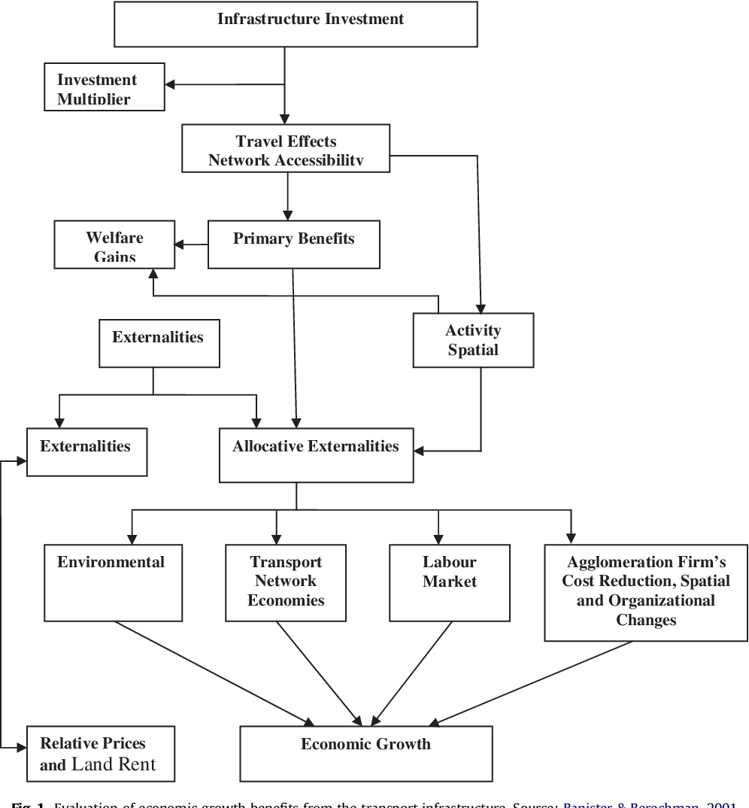
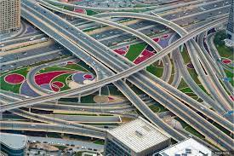
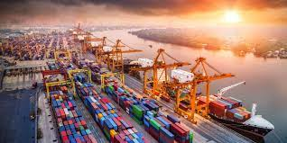
INTRODUCTION
Notes:
PRASHANT : The capital expenditure done by the government to build various infrastructure like roads, railways, ports, etc. enhance accessibility and facilitate trade, improve mobility, generate greater employment opportunities, and boost overall economic productivity. The logistics cost for the Indian economy is around 14-16% as compared to around 8% for China and 10-11% for western economies. As a result of this manufacturing as a % of GDP peaked at around 17% of GDP in 2006 and has been on decline ever since.

Slide 3
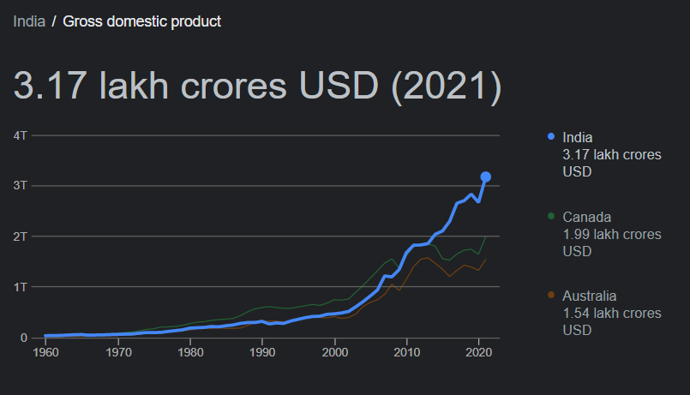
UNDERSTANDING ECONOMIC OUTPUT
GOVT SPENDING
CONSUMPTION
COMPONENTS
OF GDP
INVESTMENTS
NET EXPORTS
Notes:
NALIN : GDP is the most commonly used metric to measure the economic output of an entity, it is the standard measure of the value added created through the production of goods and services in a country during a certain period and has been represented by the following equation : Y = C + I + G + (X - M)

Slide 4
COMPONENTS OF GOVERNMENT SPENDING
Govt Spending
Revenue Expenditure
Capital Expenditure
Interest payments
Payments of salaries and pensions
Grants and subsidies
Maintenance of assets
Education and health services
Construction of roads, railways, ports, airports, power plants and bridges.
Purchase of land and machinery.
Notes:
RAJESH
Revenue Expenditure : It is expenditure for the normal running of government departments and various services, interest charges on debt incurred by the government, subsidies and so on. Broadly speaking, expenditure which does not result in the creation of assets is treated as revenue expenditure.
Capital Expenditure : It is the part of the government spending that goes into the creation of assets like schools, colleges, hospitals, roads, bridges, dams, railway lines, airports and seaports. It also covers the acquisition of equipment and machinery by the government, including those for defense purposes.

Slide 5
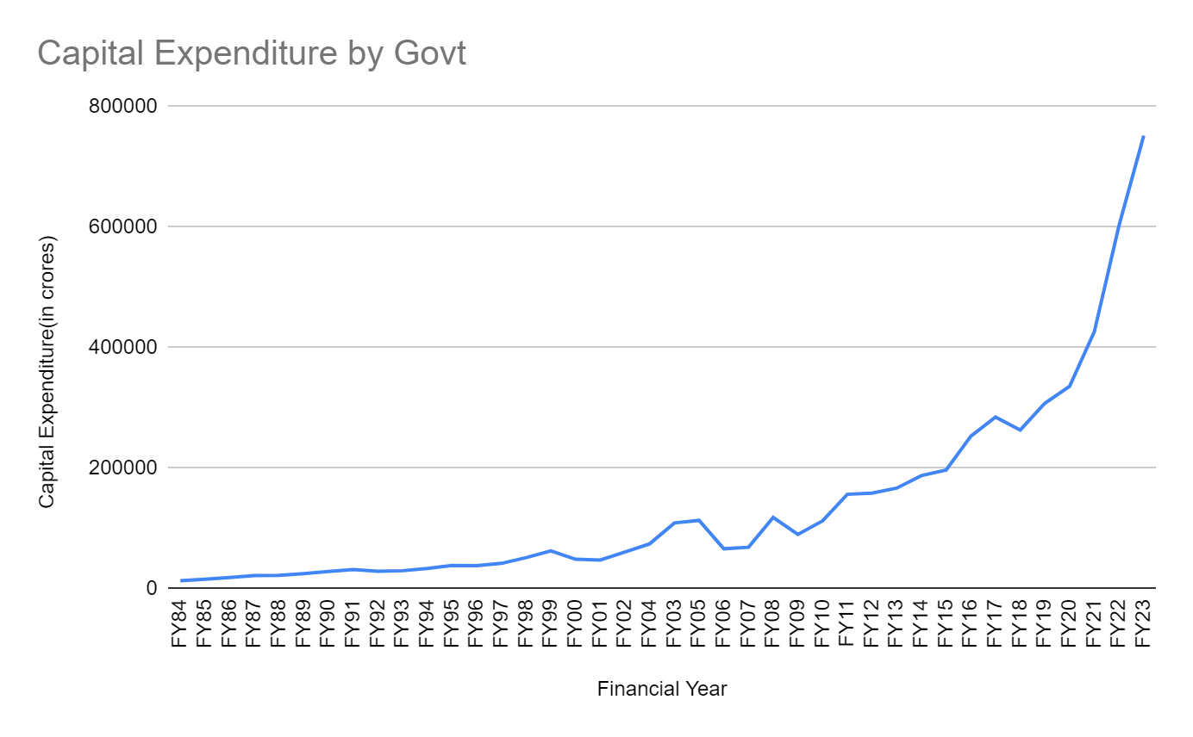
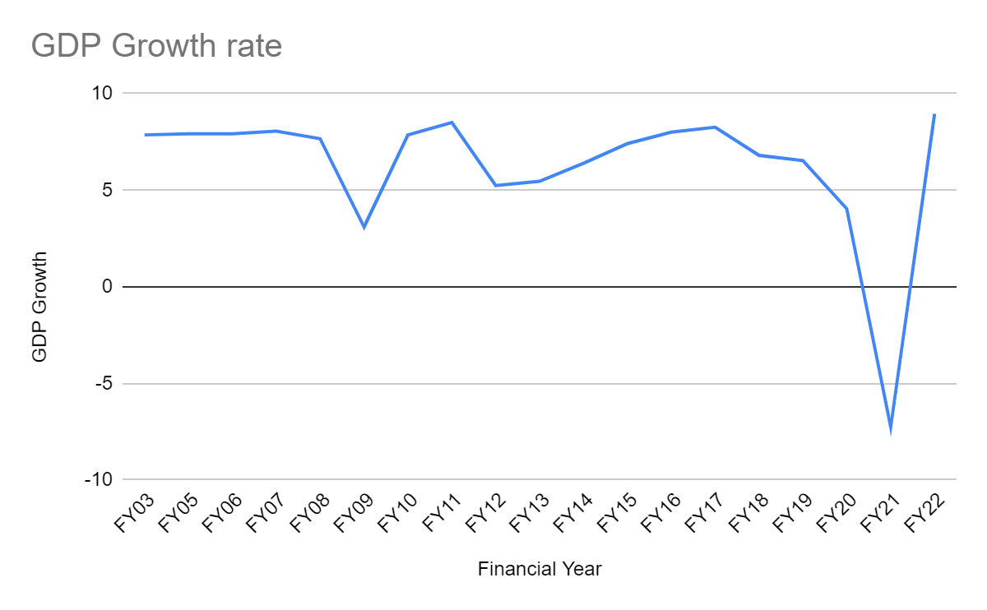
Significance of Capital expenditure
Notes:
PRASHANT : As the Indian economy has slowed after FY17 due to global headwinds and lack of private sector investment the government has started building infrastructure through capital spending which can be clearly seen in form of the meteoric rise in capital expenditure outlay by the government. Rather than providing subsidies and handouts to people this way of injecting money is much more beneficial as even after the spending is done and the workers who were paid wages have spent the money they earned, in the long term we have an asset that helps in improving economic efficiency.

Slide 6
THEORY
Now the change in national output in relation to government spending is represented by the following equation.
ΔY = (1/(1-MPC))*G
Where, ΔY is change in national output, ΔG is change in government spending and MPC is marginal prosperity to consumer
Y_{t} - Y_{t-1} = ꞵ₁(G_{t} - G_{t-1}) + e
Where ꞵ₁ is the estimation of 1/(1-MPC). Now to get the coefficient of capital spending we split the government spending into revenue spending and capital spending.
G = RE + CE
ΔG = Δ(RE + CE)
ΔG = ΔRE + ΔCE
(1/(1-MPC))ΔG = (1/(1-MPC))ΔRE + (1/(1-MPC))ΔCE
ΔY = (1/(1-MPC))ΔRE + (1/(1-MPC))ΔCE
As we can see, the coefficients of ΔRE and ΔCE are theoretically the same.
Notes:
PRASHANT

Slide 7
Year | GDP | Revenue expenditure | Capital expenditure | Total Expenditure
1983-84 | 209356.00 | 22251 | 13283 | 35534
1984-85 | 235113.00 | 27691 | 15941 | 43632
1985-86 | 262717.00 | 33924 | 18742 | 52666
1986-87 | 292924.00 | 40860 | 22056 | 62916
1987-88 | 332068.00 | 46174 | 22087 | 68261
1988-89 | 396295.00 | 54106 | 25005 | 79111
1989-90 | 456540.00 | 64210 | 28698 | 92908
1990-91 | 531814.00 | 73516 | 31782 | 105298
1991-92 | 613528.00 | 82292 | 29122 | 111414
1992-93 | 703723.00 | 92702 | 29916 | 122618
1993-94 | 817961.00 | 108169 | 33684 | 141853
1994-95 | 955386.00 | 122112 | 38627 | 160739
1995-96 | 1118586.00 | 139861 | 38414 | 178275
1996-97 | 1301788.00 | 158933 | 42074 | 201007
1997-98 | 1447613.00 | 180335 | 51718 | 232053
1998-99 | 1668739.00 | 216461 | 62879 | 279340
1999-00 | 1858205.00 | 249078 | 48975 | 298053
2000-01 | 2000743.00 | 277839 | 47753 | 325592
2001-02 | 2175260.00 | 301468 | 60842 | 362310
2002-03 | 2343864.00 | 338713 | 74535 | 413248
2003-04 | 2625819.00 | 362074 | 109129 | 471203
2004-05 | 2971464.00 | 384329 | 113331 | 498252
2005-06 | 3390503.00 | 439376 | 66362 | 505738
2006-07 | 3953276.00 | 514609 | 68778 | 583387
2007-08 | 4582086.00 | 594433 | 118238 | 712671
2008-09 | 5303567.00 | 793798 | 90158 | 883956
2009-10 | 6108903.00 | 911809 | 112678 | 1024487
2010-11 | 7248860.00 | 1040723 | 156605 | 1197328
2011-12 | 8391691.00 | 1145785 | 158580 | 1304365
2012-13 | 9388876.00 | 1243514 | 166858 | 1410372
2013-14 | 10472807.00 | 1371772 | 187675 | 1559447
2014-15 | 12467959.00 | 1466992 | 196681 | 1663673
2015-16 | 13771874.00 | 1537761 | 253022 | 1790783
2016-17 | 15391669.00 | 1690584 | 284610 | 1975194
2017-18 | 17090042.00 | 1878833 | 263140 | 2141973
2018-19 | 18886957.00 | 2007399 | 307714 | 2315113
2019-20 | 20351013.00 | 2350604 | 335726 | 2686330
2020-21 | 19745670.00 | 3083519 | 426317 | 3509836
Notes:
RAJESH : The following is the data for GDP, capital expenditure, revenue expenditure and total expenditure by central government from FY84 to FY21 that we have used in our study.

Slide 8
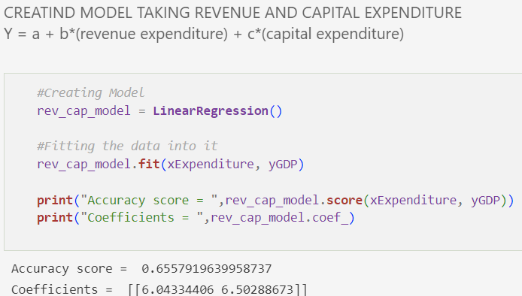
CREATING FIRST MODEL
Notes:
NALIN : Calculating the short term multiplier effects of both revenue and capital expenditure by creating a linear regression model and using the data, we see that while its greater for capital expenditure even in short term the difference isn't very big and thus we can try and reduce the complexity of the model by reducing variables.

Slide 9
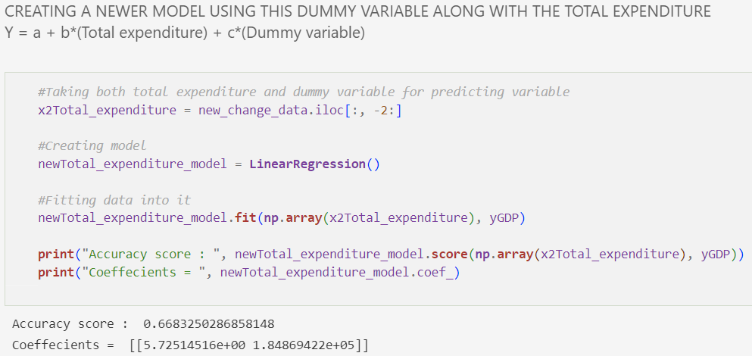
USING TOTAL EXPENDITURE
Notes:
PRASHANT : Instead of using capital and revenue expenditure, we have not used total expenditure while adding a dummy variable to account for the economic reforms of 1991 as Indian economy underwent massive systemic changes afterwards with trade barriers being lifted and running private enterprise becoming easier. The accuracy of the model increases increases

Slide 10
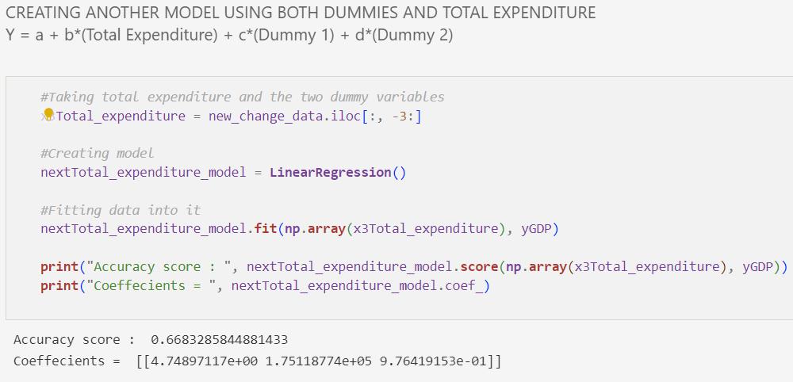
ADDING ANOTHER DUMMY
Notes:
RAJESH : Now we have tried adding another dummy variable to the model to see if there is another significant increase in accuracy of the model but as we can see there isn't much increase. So now we have to do F test to see if this increase in accuracy is statistically significant.

Slide 11
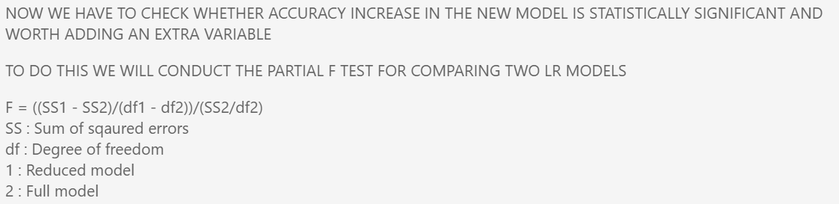
F-TEST
Notes:
PRASHANT

Slide 12
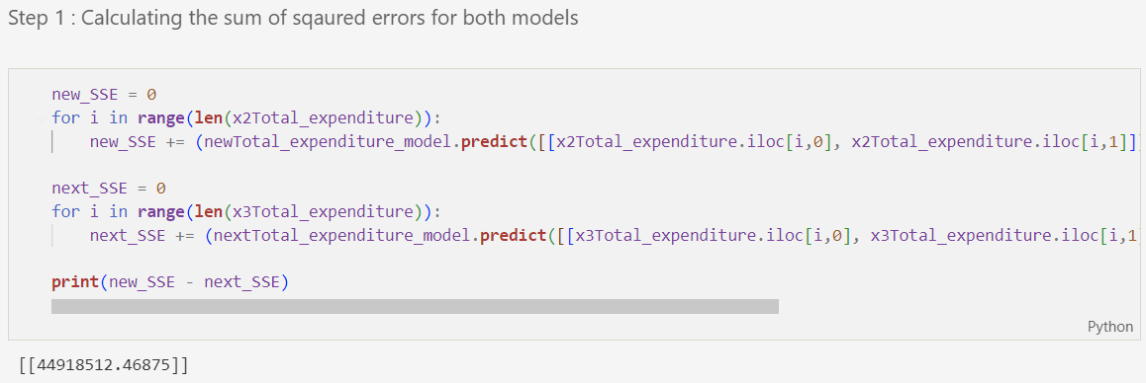
Notes:
First we calculate the sum of squared errors for both models and their difference

Slide 13
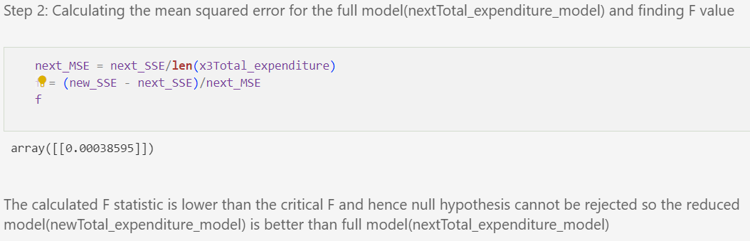
Notes:
NALIN

Slide 14
Results
The multiplier effect for infrastructure spending done by the government over the period of time under observation is 5.725 across all assets built.
The dummy variable for 1991 is important and increases accuracy significantly.
Any further dummy variables are not useful as they don't increase accuracy by a statistically significant margin.
The marginal prosperity to consumers isn’t very different in the short term for both revenue and capital expenditure.
Notes:
RAJESH

Slide 15
Limitations
The multiplier effect is calculated only for short to medium term and hence doesn't give the full picture of economic advantages.
The multiplier effect has been shown to vary from one infrastructure asset to another, for example, roads have a multiplier effect 2.5 while power sector investments like power grids have multiplier effect of 86, here we have just taken them all as one.
There are some minor distortions even after 1991 that might pile up when taken together like the government reducing its debt by contractionary fiscal policy from FY04 to FY07 and then the 2008 financial crisis. Also, the drastic increase in capital spending after 2014 due to different ideological views of the new government from the previous one.
Notes:
PRASHANT

Slide 16
THANK YOU

